Slide 1
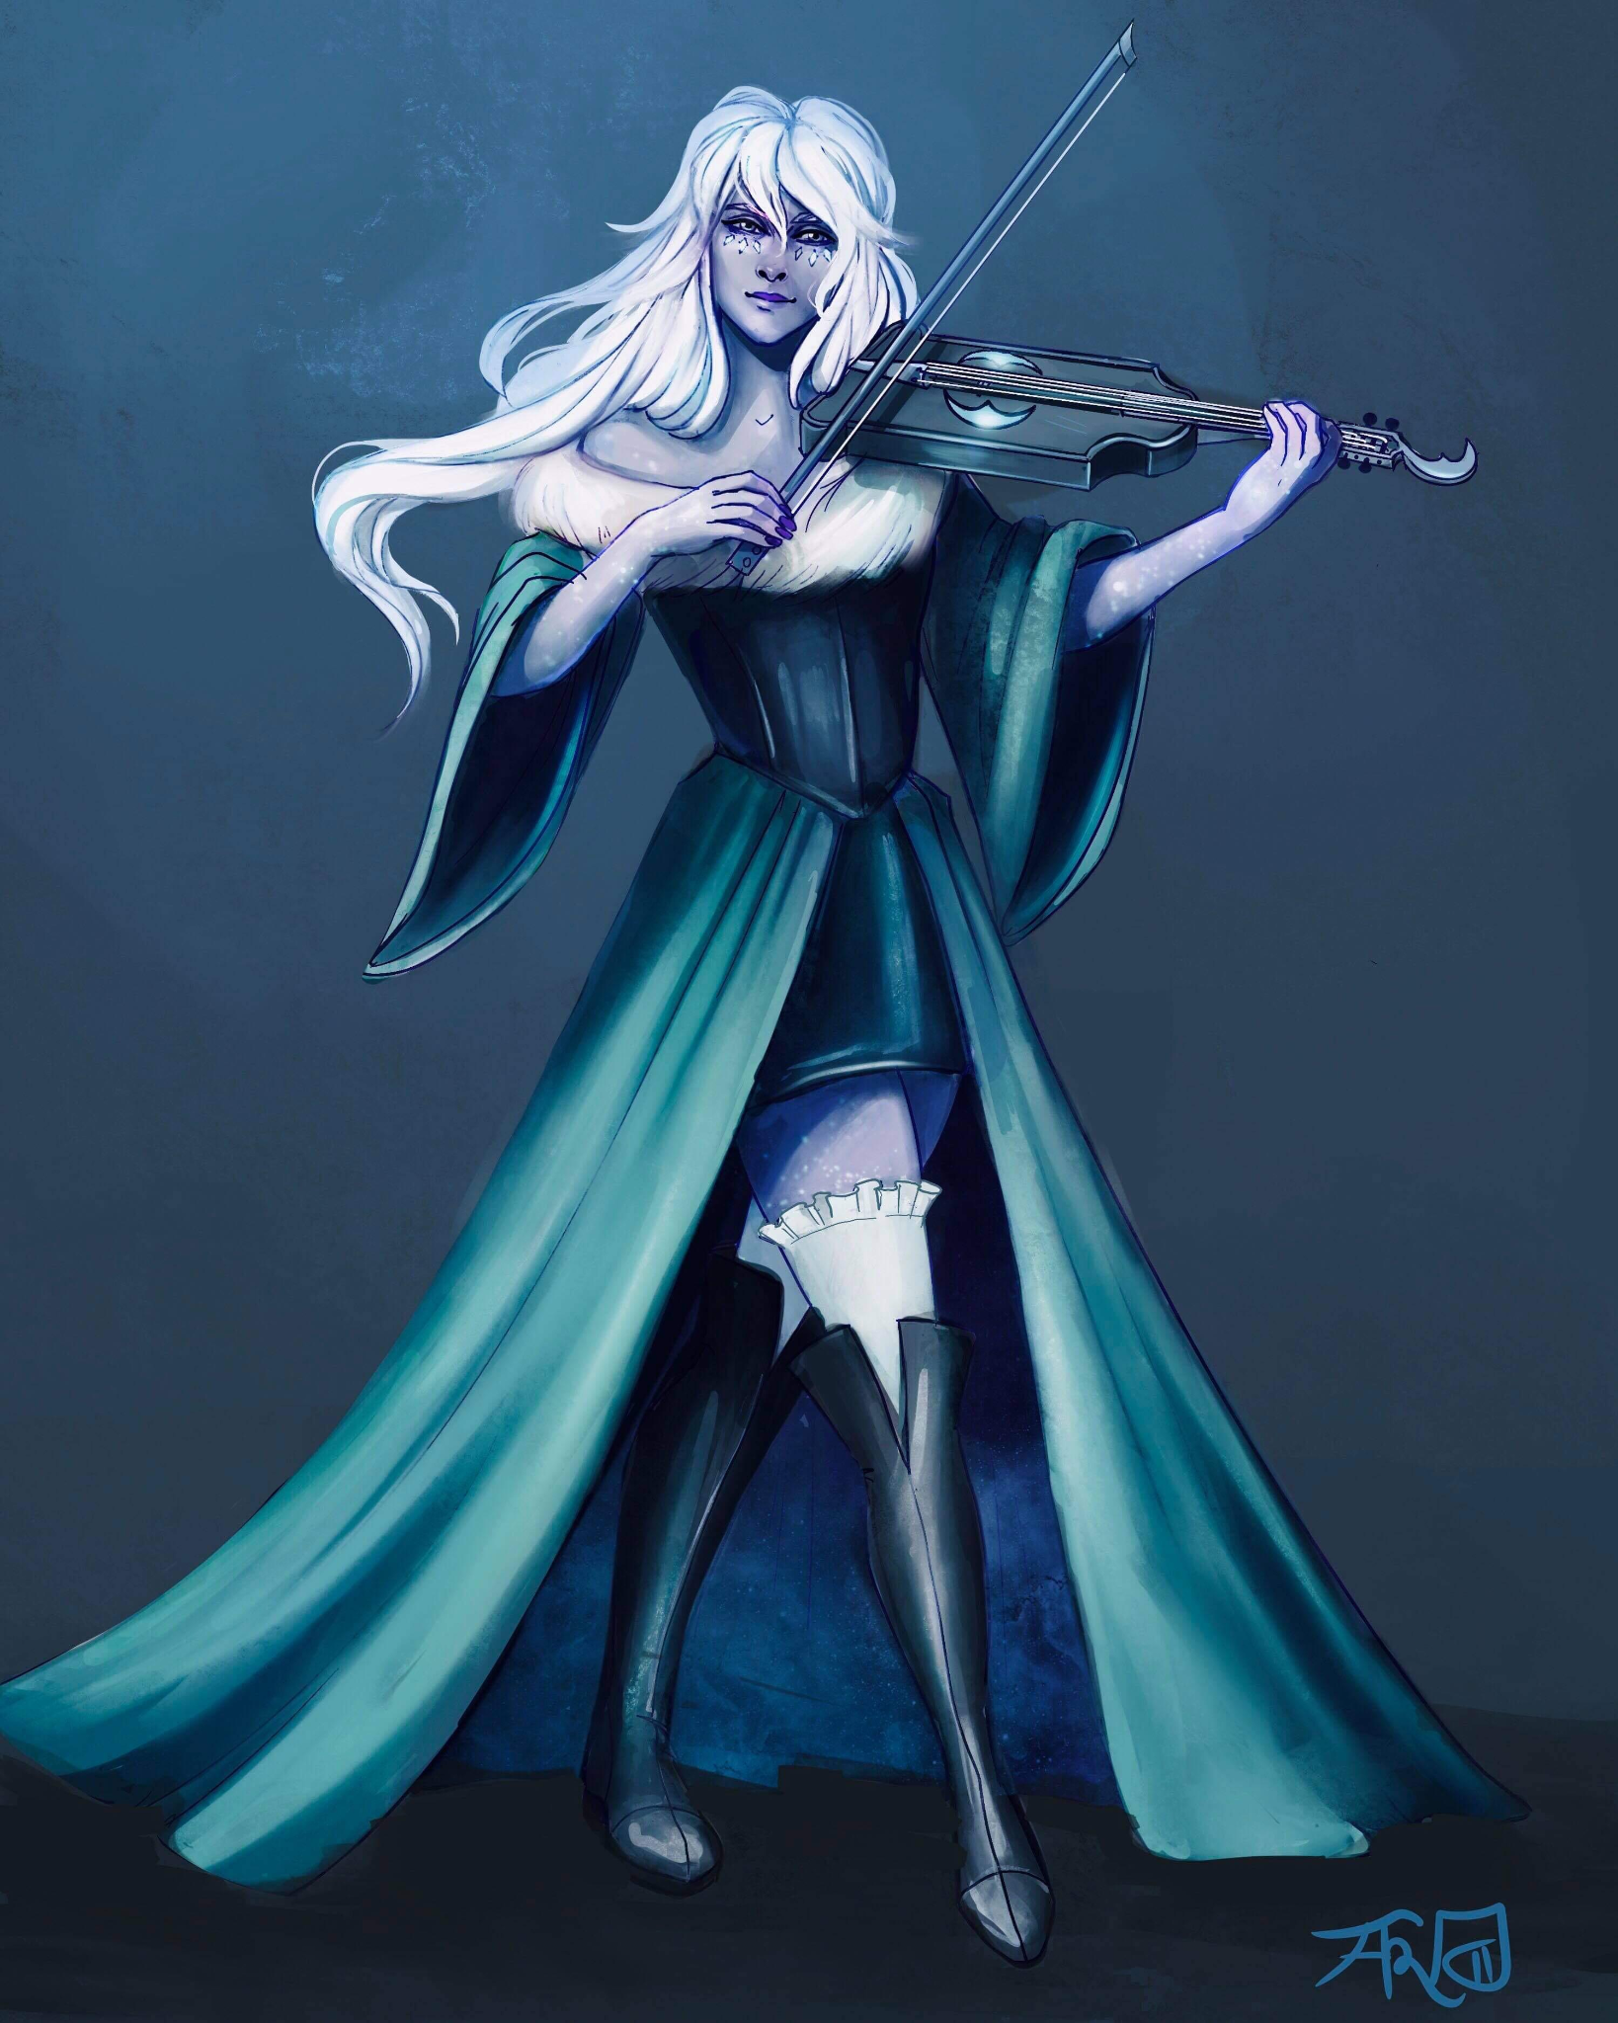
Bethany [Last Name UNKNOWN]
Assistant at the Day Dream Library

Slide 2
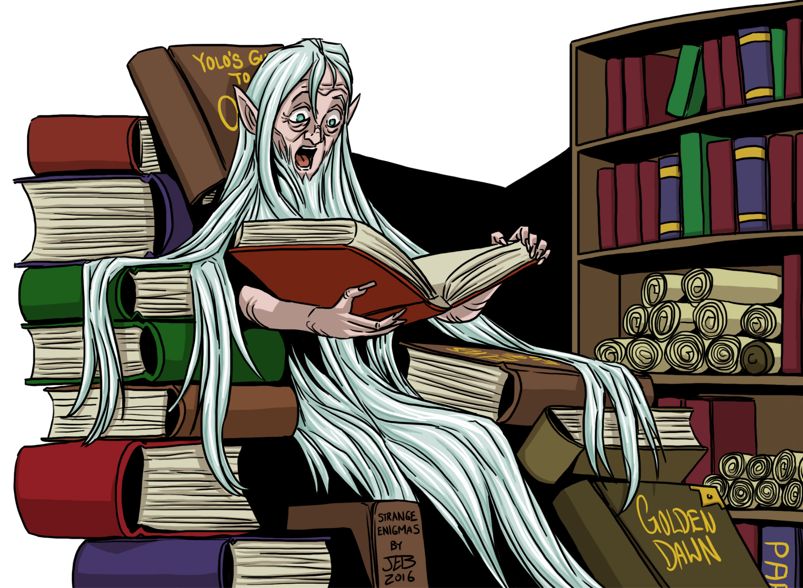
[First and Last Name UNKNOWN]
Owner of the Day Dream Library

Slide 3
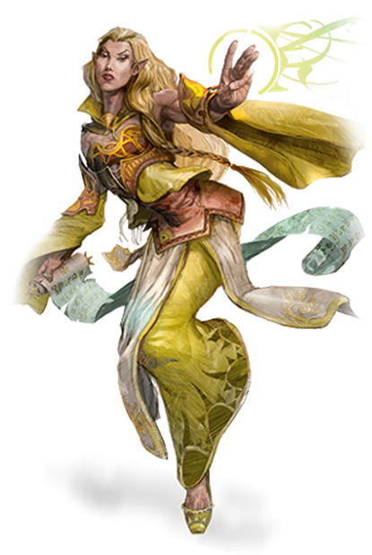
Ramora [Last Name UNKNOWN]
Traveling Adventurer
Works Part-Time at the Day Dream Library

Slide 4
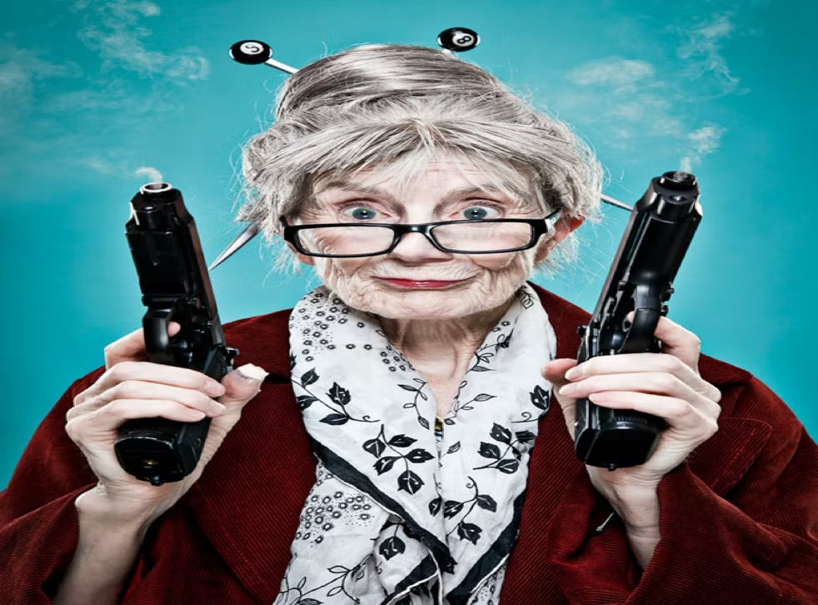
Swan [Last Name UNKNOWN]
Owner of The Thoughtful Baker Bar

Slide 5
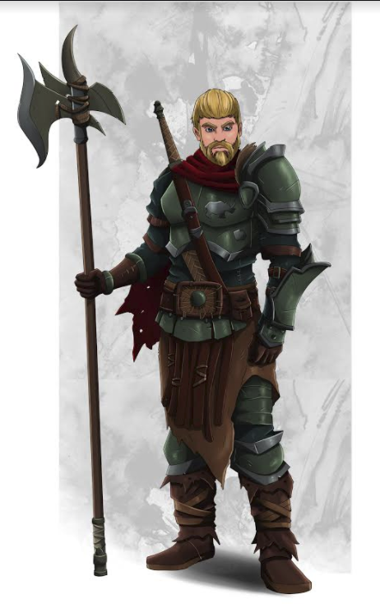
Rhino [Last Name UNKNOWN]
Ex-Arm Wrestling Champion of Helmfield

Slide 6
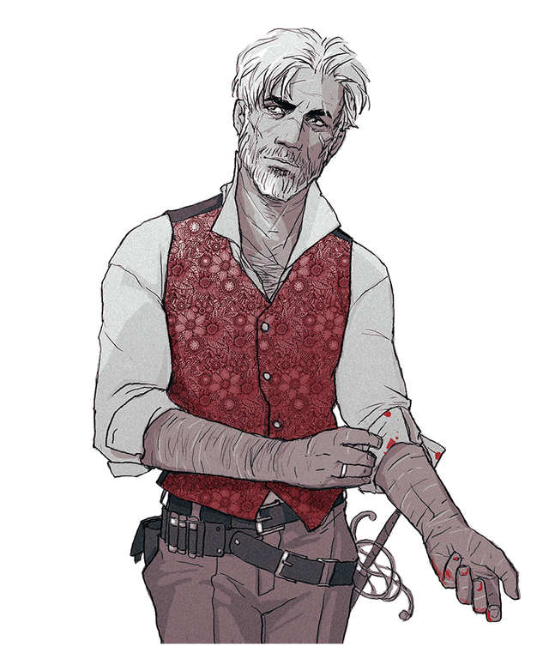
Penguin [Last Name UNKNOWN]
Close to Rhino

Slide 7
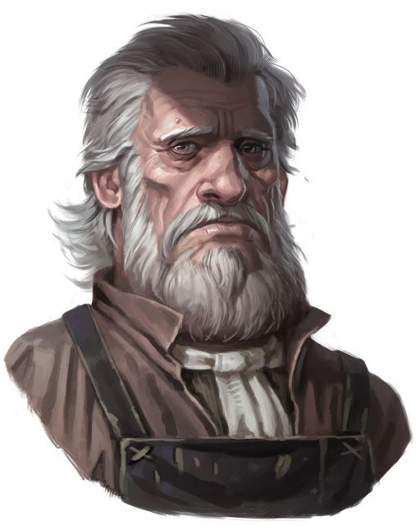
[First and Last Name UNKNOWN]
Owner of the White Basin Hotel

Slide 8
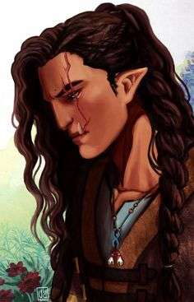
Beverly [Last Name UNKNOWN]
Owner of the Flowing Hammer
Got her scar from the Helmfield Cave

Slide 9
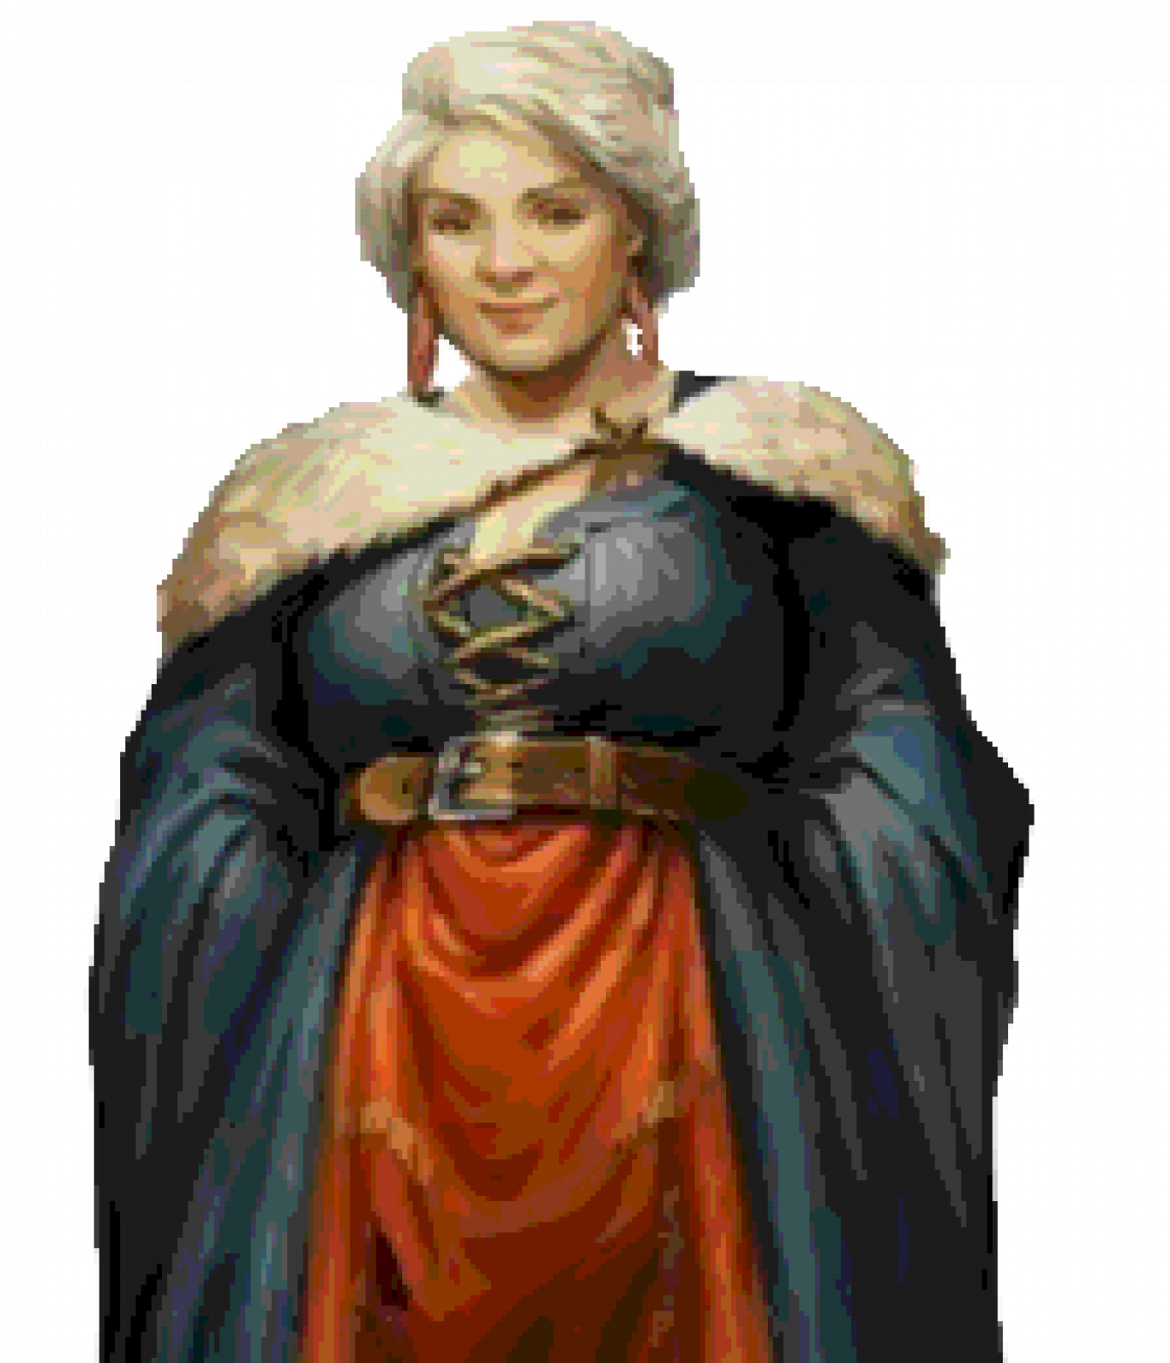
Godiva Commonbrook
Mayor of Helmfield

